Slide 1
National Association of City Transportation Officials, December 2017

Slide 2
Non-profit organization
Cycling club, incorporated in 1986, serving S. Oregon & N. California
Membership organization with 225 members
roughly 25 percent are Medford residents
annual membership fee is $20
the Club hosts weekly rides at all endurance and pace levels
Annual membership events
Ice Cream Social
BBQ and Bike Wash
Holiday party
Sponsor Ride of Silence
Co-sponsor of the Up and Down Ride (60 – 100 mile ride along the Cascades Siskiyou Scenic Bikeway)

Slide 3
The Club’s Purpose
Plan, promote and conduct bicycle rides, tours and special events.
Plan, promote and conduct bicycle safety education classes
Promote cycling as a fun and healthy activity
Promote fellowship among cyclists
Encourage bicycle commuting
Support legislation/ordinances that advance the interests of cycling safety and enjoyment
Promote awareness of cyclists’ rights and responsibilities on public thoroughfares
Improve the image of cyclists and cycling within the community at large
Engage in other cycling-related activities as deemed desirable by the Board of Directors and the membership

Slide 4
Who Bicycles?
Nationwide studies, including one in Portland, have found that the majority of citizens are “interested in cycling but concerned.” They are concerned about their SAFETY and, more particularly, afraid to share the road with motor vehicles.
Source: Four Types of Cyclists, Roger Geller, 2006

Slide 5
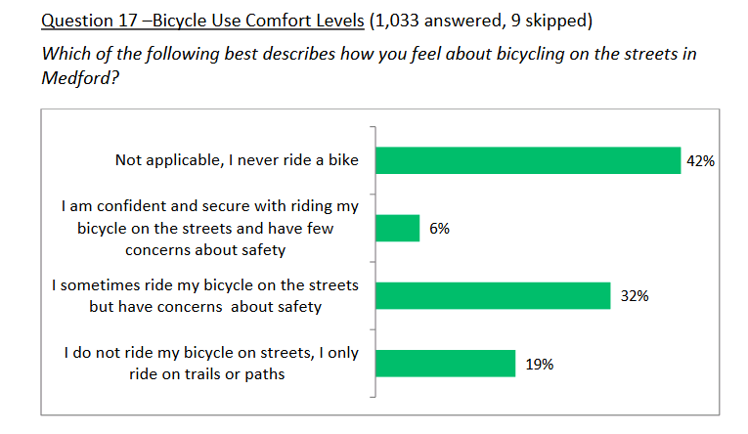
Who Rides Bicycles in Medford
The City’s survey found that almost 60 percent of Medford residents ride bikes.
Source: Summary of Medford Transportation Survey, City of Medford, August 2017

Slide 6
The Oregon Transportation Planning Rule
Oregon Administrative Rules (OAR)
The City is faced with the same challenge as posed by the Oregon Transportation Planning Rule (TPR) when the Rule was first adopted in 1991. The TPR requires the City to:
OAR 660-12-0020(3) “provide safe and convenient vehicular circulation and to enhance, promote and facilitate safe and convenient pedestrian and bicycle travel by planning a well-connected network of streets and supporting improvements for all travel modes.”
OAR 660-12-0000(3)c “Within metropolitan areas, coordinated land use and transportation plans are intended to improve livability and accessibility by promoting changes in the transportation system and land use patterns. A key outcome of this effort is a reduction in reliance on single occupant automobile use, particularly during peak periods.“

Slide 7
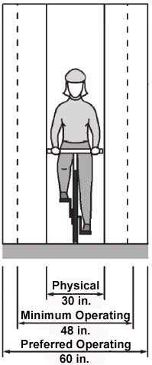
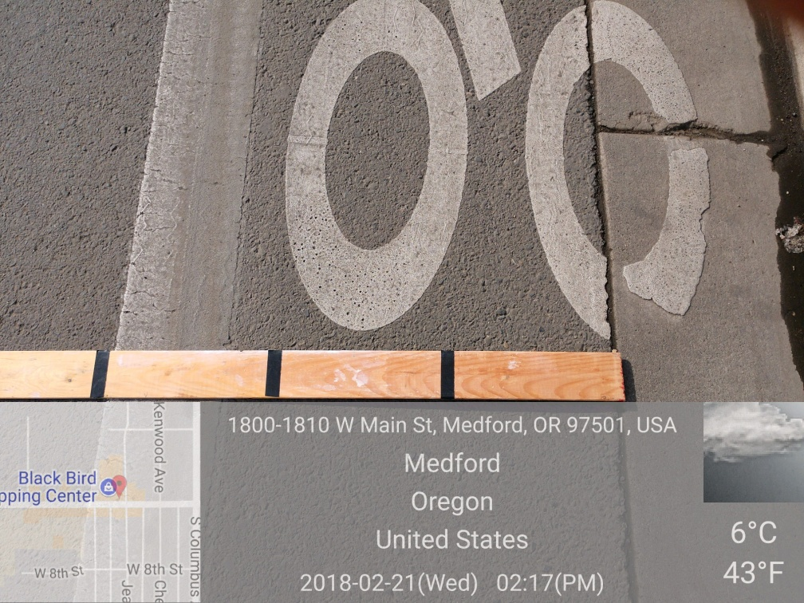
Too Narrow Bike Lanes
Medford, like the rest of the RVMPO cities, have focused almost exclusively on adding bike lanes on major streets (arterial and collector streets). The City’s efforts have often lead to overly narrow lanes for bikes despite the City’s street standards which require five feet wide bike lanes except on major arterials where the City’s code* requires bike lanes to be six feet wide (both measures include the width of the drain pan).
* Source: http://www.ci.medford.or.us/codeprint.asp?codeid=4426)
Two and one-half feet wide. That is too narrow for safety or comfort.
Riding a Bicycle Should Not
Require Bravery
Source: 2012 AASHTO Bike Guide

Slide 8
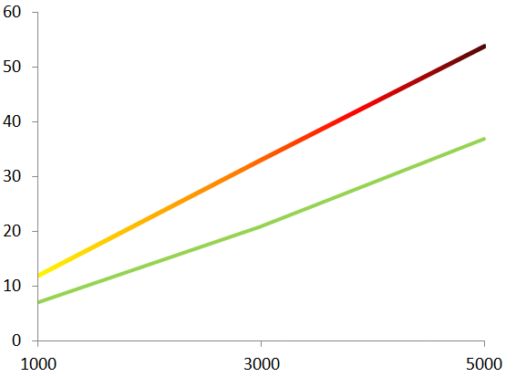
Conflicts Increase with Motor Vehicle Speeds & Volumes
This chart illustrates the number of passing events (at increasing motor vehicle average speed and volume) experienced over a 10-minute period by a bicyclist riding 10 MPH. As motor vehicle speed and volume increase, they magnify the frequency of stressful events for people riding bicycles.
Passing Events
30 MPH Average Vehicle Speed
20 MPH Average Vehicle Speed
Average Daily Traffic (ADT)
Adapted from Designing for All Ages & Abilities, NACTO, December, 2017

Slide 9
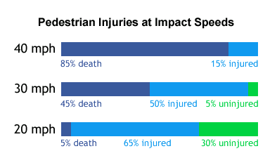
Reducing Vehicular Speeds
Decreases Crash Risk and Crash Severity
Cyclists (like pedestrians) are less likely to die and suffer fewer injuries when hit by a motor vehicle driving at 20 MPH as compared to 30 MPH or faster. “At low speeds, below about 15 miles per hour (m.p.h.), risks are low.” (AAA Foundation for Traffic Safety)
Pedestrian Injuries at Impact Speeds
Source: http://guide.saferoutesinfo.org/engineering/slowing_down_traffic.cfm

Slide 10
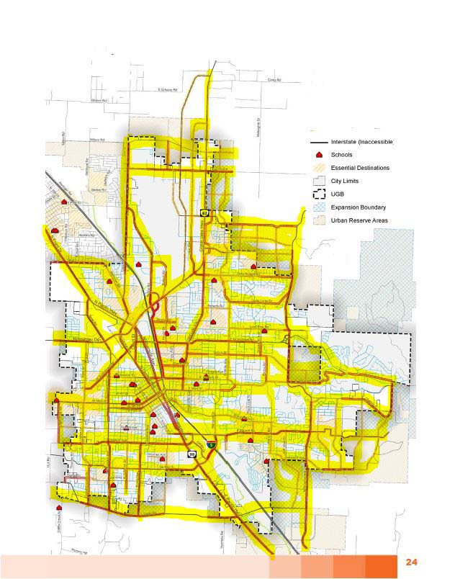
Existing Unsafe Bicycle Facilities In
Medford
For Most Adults
Youth
Seniors
Disabled Persons
and
Families
Medford
Based upon City of Medford 11/10/17 draft TSP - Figure 10

Slide 11
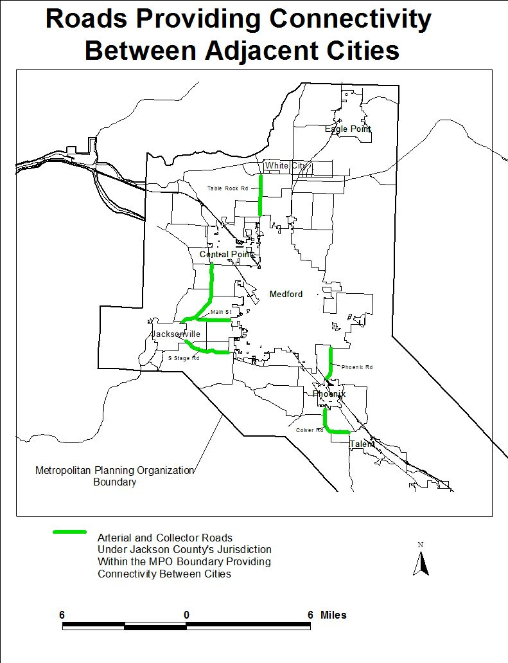

Slide 12
Planning Benchmarks and Outcomes
Despite the more than doubling of the percentage of arterial and collector streets with bike lanes (Measure 3), the bike mode share has remained in the neighborhood of one percent and the region has slipped behind its adopted Bike/Ped mode share benchmark (Measure 1).
21%
28%
37%
37%
54%
48%
60%
Percentage Bike/Ped Mode Share
Bike/Ped
8.2
The percentage of total daily trips taken by a combination of bicycle and walking (non-motorized) modes. Determined from best available data (e.g. model output and/or transportation survey data).
8.2%
8.2%
7.3%
8.4%
8.2%
9.8%
11%
Source: Alternative Measures Report, Rogue Valley MPO, 2015

Slide 13
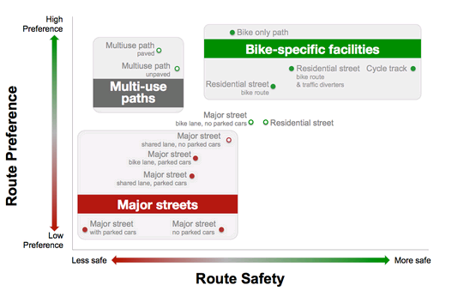
Bike Facility Preference and Safety
People riding bikes prefer “more safe” and “high preference” bike-specific facilities. Bike specific facilities include: residential bike routes, residential street bike routes & traffic diverters, cycle track (i.e. separated bikeways or protected bikeways), and bike only paths.
W
Source: Safety & Route Type, Bicyclists’ Injuries and the Cycling Environment, University of British Columbia

Slide 14
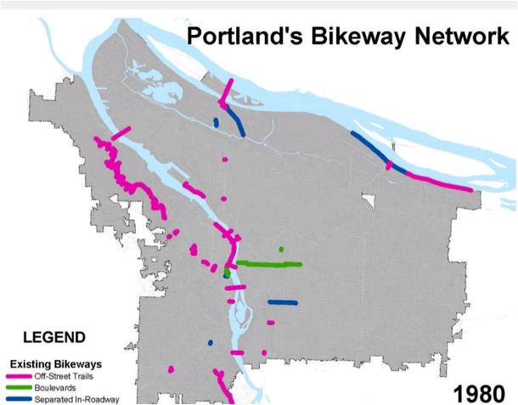

Slide 15
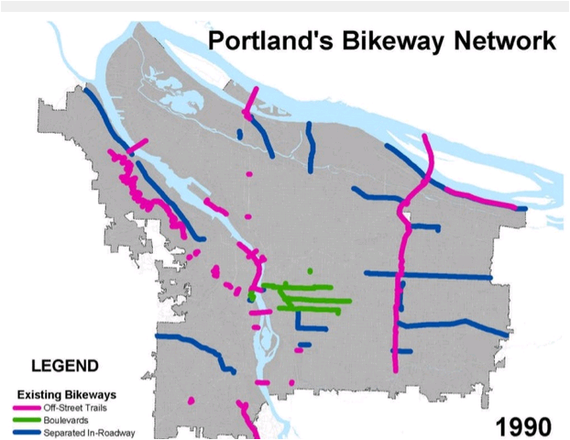
Bicycle Mode Share: 1.0 percent

Slide 16
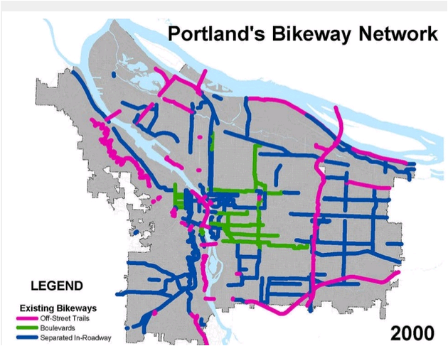
Bicycle Mode Share: 1.8 percent

Slide 17
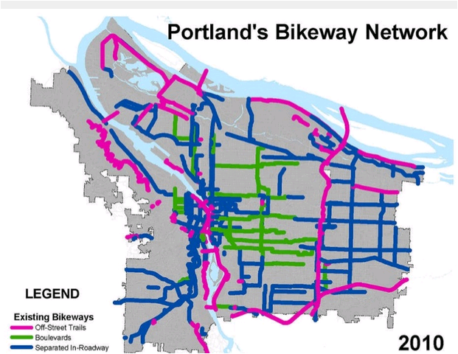
Bicycle Mode Share: 6.1 percent
Portland’s TSP provides for a 25% bike mode share by 2035.

Slide 18
National Association of City Transportation Officials, December 2017

Slide 19
What are “All Ages & Abilities” bike facilities?
Safe - Better bicycle facilities are directly correlated with increased safety for people walking and driving as well.
Comfortable – Bikeways that eliminate stress will attract traditionally under-
represented bicyclists, including women, children, and seniors.
Equitable - Poor or inadequate infrastructure forces people bicycling to choose between feeling safe and following the rules of the road, and induces wrong-way and sidewalk riding. Where street design provides safe places to ride and manages motor vehicle driver behavior, unsafe bicycling decisions disappear, making ordinary riding safe and legal and reaching more riders.

Slide 20
What is Meant by “All Ages & Abilities?”
They are PEOPLE who are:
Children: School-age children are an essential cycling demographic but face unique risks and often have less ability to detect risks or negotiate conflicts.
Seniors: People aged 65 and over are the fastest growing population group in the US, and the only group with a growing number of car-free households. Bikeways need to serve people with lower visual acuity and slower riding speeds.
Women: Women are consistently under-represented as a share of total bicyclists, but the share of women riding increases in correlation to better riding facilities.
People Riding Bike Share: Bike share users range widely in stress tolerance, but overwhelmingly prefer to ride in high-quality bikeways. All Ages & Abilities networks are essential to bike share system viability.
People of Color
While Black and Latino bicyclists make up a rapidly growing segment of the riding population, a recent study found that fewer than 20% of adult Black and Latino bicyclists and non-bicyclists feel comfortable in conventional bicycle lanes; fear of exposure to theft or assault or being a target for enforcement were cited as barriers to bicycling.
Families
The combination of children, mothers, fathers, grandmothers grandfathers, aunts, uncles, and cousins create a unique set of challenges but their need for safety is easily understood.

Slide 21
What is Meant by “All Ages & Abilities?” - continued
They are PEOPLE who are:
Low-Income Riders
Low-income bicyclists make up half of all Census-reported commuter bicyclists, relying extensively on bicycles for basic transportation needs like getting to work. An All Ages & Abilities bikeway is often needed to bring safe conditions to the major streets these bicyclists already use on a daily basis.
People with Disabilities
People with disabilities may use adaptive bicycles including tricycles and recumbent handcycles, which often operate at lower speeds, are lower to the ground, or have a wider envelope than other bicycles. High-comfort bicycling conditions provide mobility, health, and independence, often with a higher standard for bike infrastructure needed.
People Moving Goods or Cargo
Bicycles and tricycles outfitted to carry multiple passengers or cargo, or bicycles pulling trailers, increase the types of trips that can be made by bike, and are not well accommodated by bicycle facilities designed to minimal standards.
Confident Cyclists
The small percentage of the bicycling population who are very experienced and comfortable riding in mixed motor vehicle traffic conditions are also accommodated by, and often prefer, All Ages & Abilities facilities, though they may still choose to ride in mixed traffic.

Slide 22
The All Ages & Abilities Design Toolbox
Five major types of bikeway provide for most bike network needs. Each facility type is appropriate as an All Ages & Abilities bikeway in relevant street contexts. The NACTO Urban Bikeway Design Guide provides detailed guidance on bikeway facilities.
1 - Low-Speed Shared Streets
2 - Bicycle Boulevards
3 - Buffered & Conventional Bicycle Lanes
4 - Protected Bicycle Lanes (also known as Separated Bike Lanes or Cycle Tracks)
5 - Shared-Use & Bicycle Paths

Slide 23
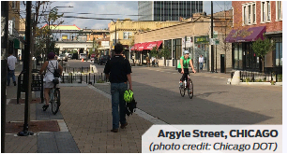
1 - Low-Speed Shared Streets
Very low operating speeds
Volume of people walking/bicycling greater than motor vehicle volume
There are no local examples of this type of street.

Slide 24
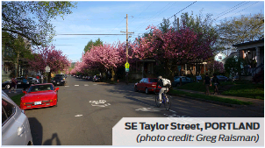
2 - Bicycle Boulevards (or neighborhood greenways)
Provide continuous comfortable bicycle routes through the local street network
Often on narrow streets with no major destinations
Traffic calming and diverting motor vehicle traffic may be needed
Genesssee and Cottage Streets could serve as a bicycle boulevard with
speeds reduced to 20 MPH.

Slide 25
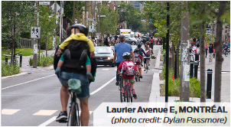
3 - Buffered & Conventional Bicycle Lanes
Improve safety and comfort for all users
Suitable where motor vehicle speeds are less than 25 MPH and volumes under 2,500
Buffered bike lanes are almost always higher comfort than conventional bike lanes
Jaunipero (in SE Medford) is a good example of where conventional bike lanes are appropriately matched with speeds and traffic volumes.
Notes:
Buffered & Conventional Bicycle Lanes provide organized space for bicycling, and are often part of street reconfiguration projects that improve safety and comfort for all users. Bicycle lanes are an important tool to improve comfort and safety on streets where the number of passing events is too high for comfortable mixed-traffic bicycling, but where curbside activity, heavy vehicles, and lane invasion are not significant sources of conflict. Buffered bike lanes are almost always higher comfort than conventional bike lanes. In many cases, cross-sections with room for buffered bicycle lanes also have room for protected bicycle lanes.

Slide 26
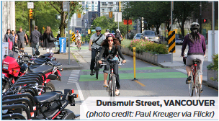
4 - Protected Bicycle Lanes
(also known as Separated Bike Lanes or Cycle Tracks)
Use a combination of horizontal and vertical separation
Needed when motor vehicle speeds exceed 25 MPH and volumes exceed 6,000 vehicles per day
Robustness of bikeway separation often scales with motor vehicle speeds and volumes
There are no local examples of this type of street.

Slide 27
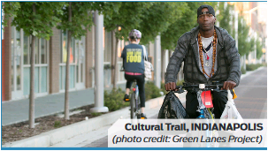
5 - Shared-Use & Bicycle Paths
Can serve as the backbone of an on-street All Ages & Abilities network
Usually do not take riders to their destinations
Ideally bicycles should be separated from pedestrians (where volumes are significant)
The Bear Creek Greenway is a good local example of a shared-use path.

Slide 28
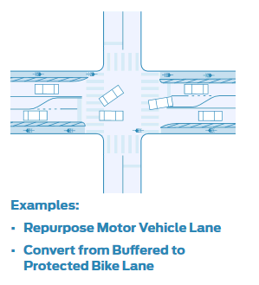
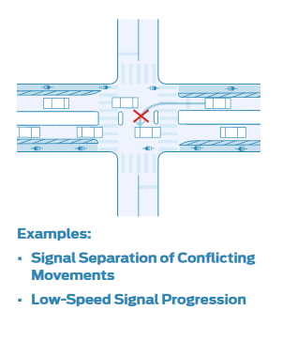
Changing the Street: Design, Operation, Networks
Design
Changing the cross-section of a street in order to provide bike lanes, buffered bike lanes, protected bike lanes, or other dedicated bicycle infrastructure.
Change Operation
Operational changes—such as speed reduction, signalization and other
conflict management, and proactive curbside management

Slide 29
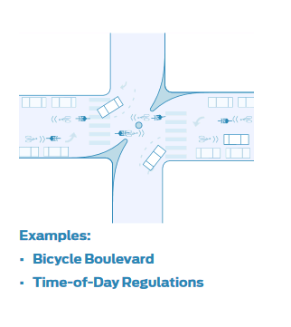
Changing the Street: Design, Operation, Networks (continued)
Change the Network
Diverting motor vehicle traffic from a street, changing travel direction, (dis)allowing specific types of curbside access, and making other changes

Slide 30
Benefits
• Community health
Two -thirds of adults, and nearly one-third of children, are considered overweight or obese.
• Improved mobility and reduced motor vehicle congestion
Gives people who cannot drive, more and cheaper options for getting around independently to meet everyday needs.
• Neighborhood livability
When residents are out on foot or by bike, they interact more with neighbors. Residential streets become calmer and quieter.
• More vibrant economy
Lower transportation costs for individuals and families; increased property values in traffic-calmed neighborhoods; savings to cities from less wear and tear on streets and less demand for roadway improvements and parking lots.
• Improved environment
Reduced air pollution and emissions of greenhouse gases. Other environmental benefits include energy savings; less noise pollution; less water pollution; and even reduced pressure to develop
agricultural and open space.
.

Slide 31
Conclusions
All Ages and Abilities designs are achievable
All Ages and Abilities designs offer multiple approaches to creating a safe and convenient bicycle network
More of the region’s citizens will bicycle with safe and convenient facilities
The existing on-street bicycle transportation system is unsafe for most adults, youth, disabled, senior, and families
Though challenges lie ahead, we are confident the region’s engineers and planners can design and implement a safe and convenient bicycle network

Slide 32
How Can You Help?
Modify the RTP to reflect a commitment to “all ages and abilities” designs.
Modify the RVMPO benchmarks to provide for a 10 percent (or higher) mode share for bikes by 2035.
Modify the MTIP project ranking criteria to prioritize projects that include “all ages and abilities” designs.
Provide for dedicated funding for stand-alone “all ages and abilities” bike facilities projects with an emphasis on separated bikeways.
Reduce the posted speeds:
▪ On residential streets to 20 MPH (see ORS 810.180(8)
▪ On all streets with bicycle facilities, that do not conform to the NACTO designs, to a maximum of 20 MPH* (see ORS 810.180(5) - as a safety measure)
Thank YOU!

Slide 33
The End
Return To Siskiyou Velo Homepage
Thank You.

Slide 34
https://medford.maps.arcgis.com/apps/webappviewer/index.html?id=b5009c630eeb4d6b97a96d98b8b6420e

